Slide 1
Information Privacy
&
Privacy and the Government
Sections 5.3.7 - 6.2.3
A probably too-long presentation
by
Austin Meredith
Notes:
In this presentation I will not only inform you, but I might actually challenge your stances on certain subjects or policies that have to do with information privacy, and the Government’s involvement.

Slide 2

What We Will Cover
Information Privacy
Information Disclosures
Mobile Applications
Medical Records
Cookies (yum)
Data Mining
Definition & Examples
Opt-In vs Opt-Out policies
Social Network Analysis
Examples of Consumer Backlash
“Marketplace: Households”
Malls Tracking Shoppers’ Cell Phones
Instagram’s Proposed TOS Changes
Privacy and the Government
US Legislation Restricting Information Collection
Employee Polygraph Protection Act
Children’s Online Privacy Protection Act
Genetic Information Nondiscrimination Act

Slide 3
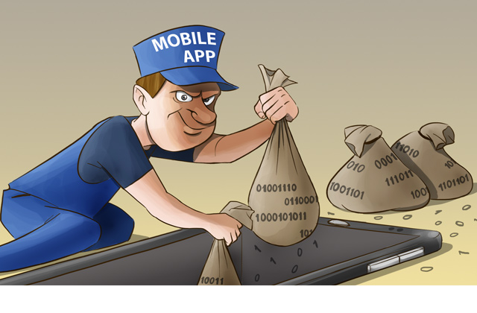
Mobile Applications
The majority of mobile applications on both iPhones & Androids collect and sell your data
Flurry, a data analysis company, has access to data from over a half million apps

Slide 4
OnStar & Vehicle “Black Boxes”
OnStar is a communication system incorporated into a vehicle’s rear view mirror
It provides emergency, security, navigation and diagnostic services, but did you know they can disable your gas pedal with “Remote Ignition Block”?
Most vehicles are also equipped with a “black box” that records data prior & during accidents

Slide 5

Medical Records
The change to paperless methods by companies (HITECH) has plenty of benefits, but also negatives
Records are now stored on databases, or in clouds, which introduces risks
Medical records are extremely personal, and leaks can cause harsh judgments

Slide 6
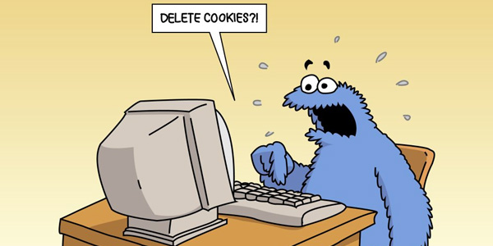
Digital Video Recorders
& Cookies
TiVo, Inc. is an example of a well-known digital video recorder
TiVo collects information on your viewing habits, as well as recording your second-by-second activity data. This can reveal personal or political interests.
Cookies store your personal information for use on the web, while Flash Cookies can be “respawned” and hold 25x The information

Slide 7
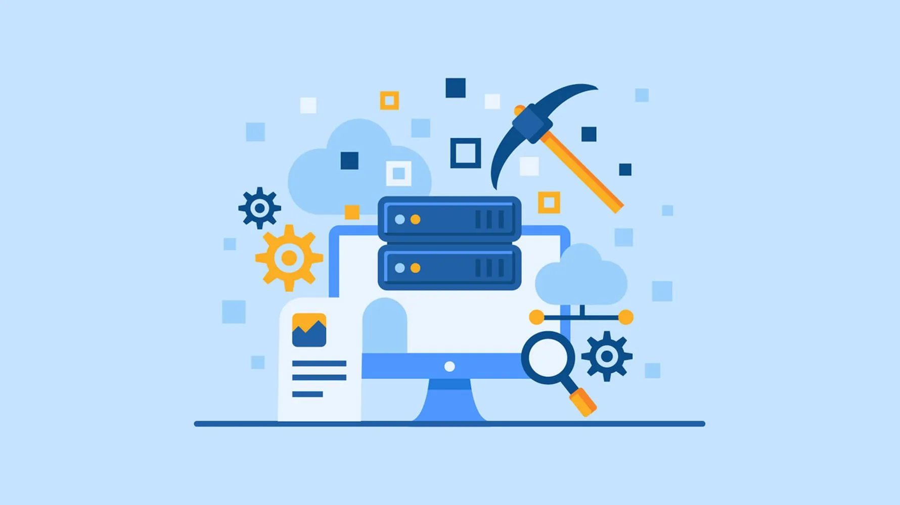
Data Mining
Information previously collected can be used as a commodity itself, used to personalize services, or target potential customers
Data Mining is collecting records and databases of records on a person, and trying to find patterns or relationships in the information to build and sell a profile
Common forms include loyalty cards, or customer surveys

Slide 8
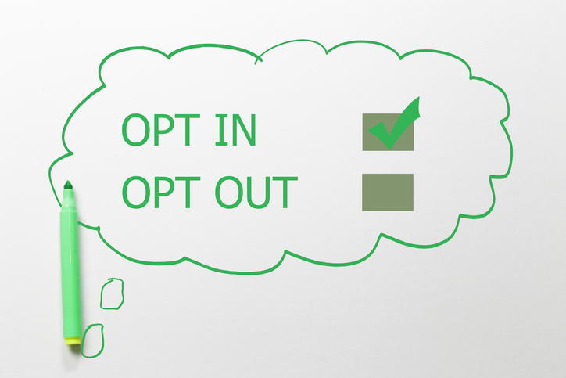
Opt-In Versus Opt-Out Policies
What rules should govern the sharing of information between organizations?
Privacy advocates prefer the opt-in policy, where users must first consent
While marketing professionals would prefer opt-out, where users must go through the process of revoking consent for data collection

Slide 9

Data Mining Examples
Google’s Personalized Search & Collaborative Filtering - The word “bass” and predicting what you might want
Target Targeting Pregnant Women - Using data from pregnant shoppers, they can predict who might be pregnant by items bought; lotion, nutritional supps.
Credit Reports - Loans, interest, employer judgement
Targeted Direct Mail And Data Brokers
Microtargeting

Slide 10
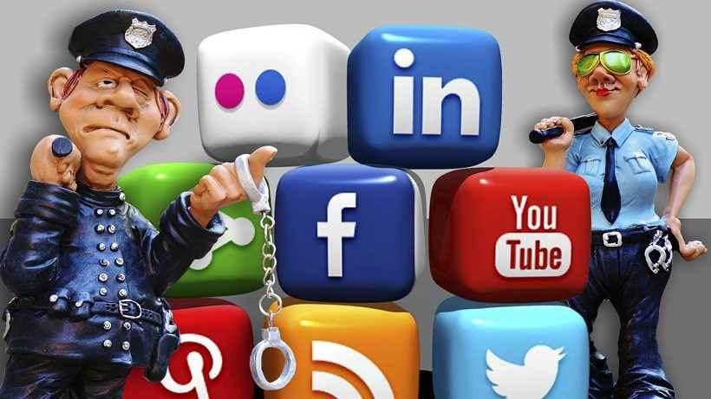
Social Network Analysis
Employers, both negative and positive, mine your social network for information
Banks evaluating riskiness of loans
Cell Phone Companies look for influencers and offer them deals to stay and share their services
Police monitor social media as well!

Slide 11
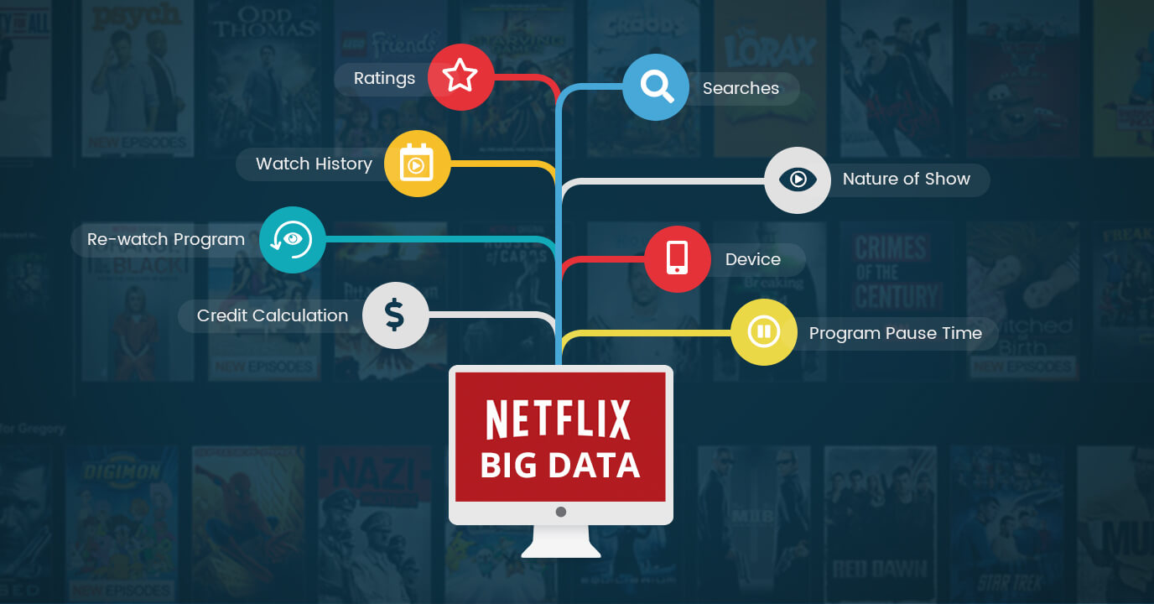
Release of “Anonymized” Datasets
Netflix Prize - Netflix uses a personalized algorithm to provide it’s subscribers with content they might enjoy. They once offered a $1 million prize to anyone who can come up with a 10% better algorithm. Turns out, bad idea.
AOL Search Dataset - AOL released a dataset containing around 20 million queries from about 650,000 AOL users. It was available to the public, and was found to contain personal information

Slide 12
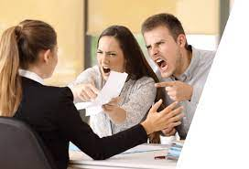
Examples of Consumer Backlash
“Marketplace: Households” - Equifax wanted a CD of 120 million household’s info
Facebook Beacon - Opt-Out social notifications of things you have bought
Malls Track Shoppers’ Cell Phones - Records time in stores, how many shop here and there, as well as unpopular areas in the mall
iPhone Apps Uploading Address Books - Path was first discovered doing it, others were too. Lead to an Opt-In policy.
Instagram’s Proposed Change of Terms of Service - IG once proposed selling your data without compensating you. Didn’t go well.

Slide 13

Privacy and the Government
US Legislation Restricting Information Collection
Employee Polygraph Protection Act (EPPA) - prevents employers from using lie detector tests under most situations, besides the government itself… of course.
Children’s Online Privacy Protection Act (COPPA) - designed to reduce the amount of information gathered from children 12 and younger using the internet, requiring prior parental consent.
Genetic Information Nondiscrimination Act (no acronym? I wonder why?) - designed to prevent discrimination in the areas of medical benefits and employment based on genetic information.

Slide 14


